Slide 1
English to Hebrew Translation using Neural Language Processor Sequence-to-Sequence Transformer
By: Talia Dagan

Slide 2
Objective
To improve performance of a sequence to sequence translation transformer translating english to hebrew.

Slide 3
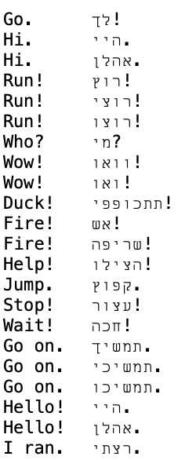
Data
An english to hebrew translation dataset from Anki, a program for intelligent flashcards
https://www.manythings.org/anki/
Data consists of english and hebrew phrases/ words
126,833 rows of data

Slide 4
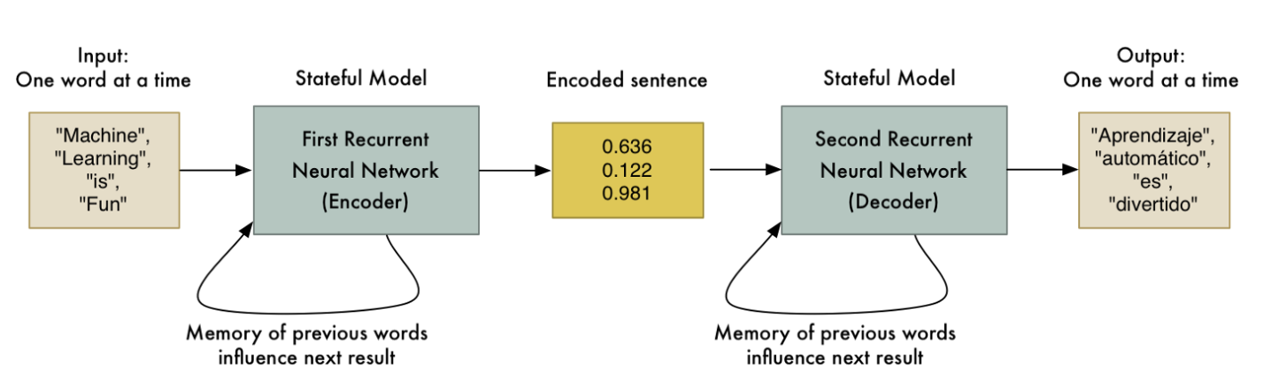
NLP Sequence to Sequence Transformer Models
Natural Language Processing using sequence to sequence transformers
An RNN layer acts as an encoder and it processes the input sequence and returns its own internal state
A second RNN layer acts as decoder and predicts the next characters of target sequence into same sequence
English translation is the source sequence and the target sequence is the Hebrew

Slide 5
Why use transformers instead of LSTM?
LSTM model’s have a hard time coping with long sequences
LSTM processes the sequences key by key separately and does not look at whole sequence at one time
Since each state depends on the previous one, it is hard to parallelize

Slide 6
How to improve performance?
In order to improve performance I changed the parameters and used different models to choose the best parameters that can increase the model’s accuracy.
Changes included:
Using batch size of 32, 64, 128
Sequence length
Changing data partition
Used two different versions of same dataset
Running at different amount of epochs (max @ 30)

Slide 7
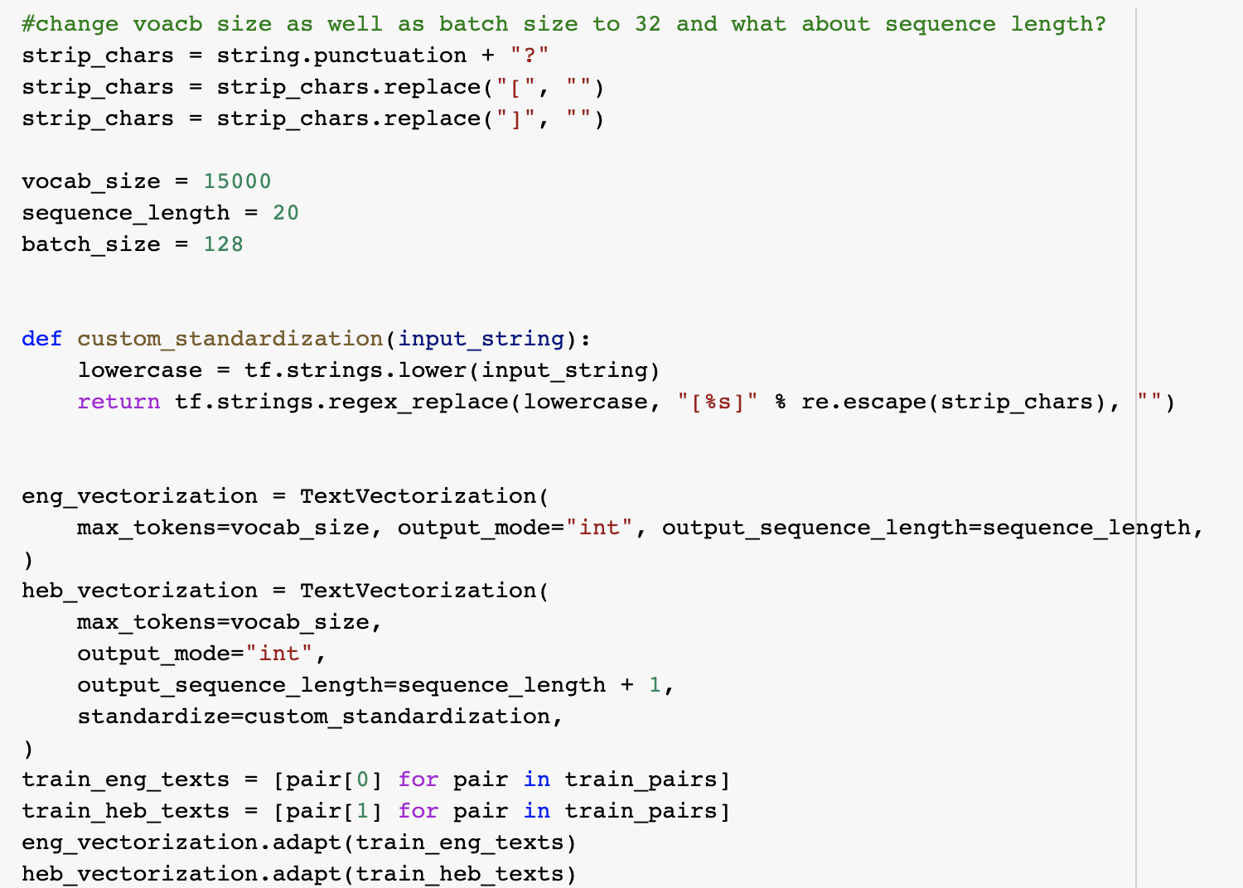
Text Vectorization
One layer is used for each language
Batch size is changed for each model

Slide 8
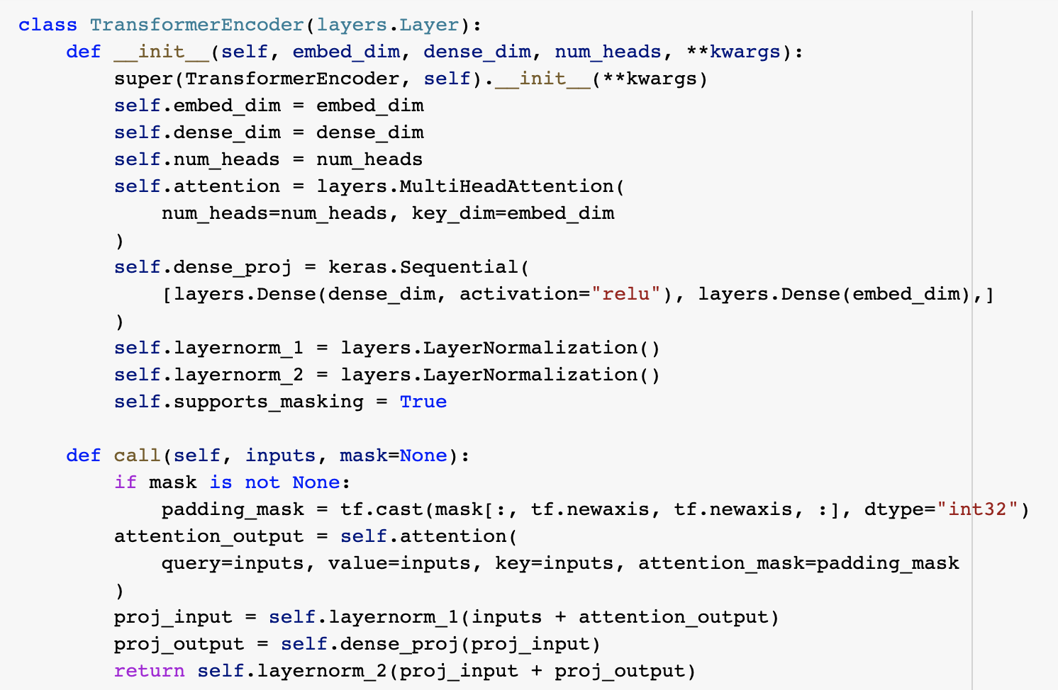
Building the Model
Transformer encoder and decoder are chained together
Positional embedding layer added so model is more aware of order

Slide 9
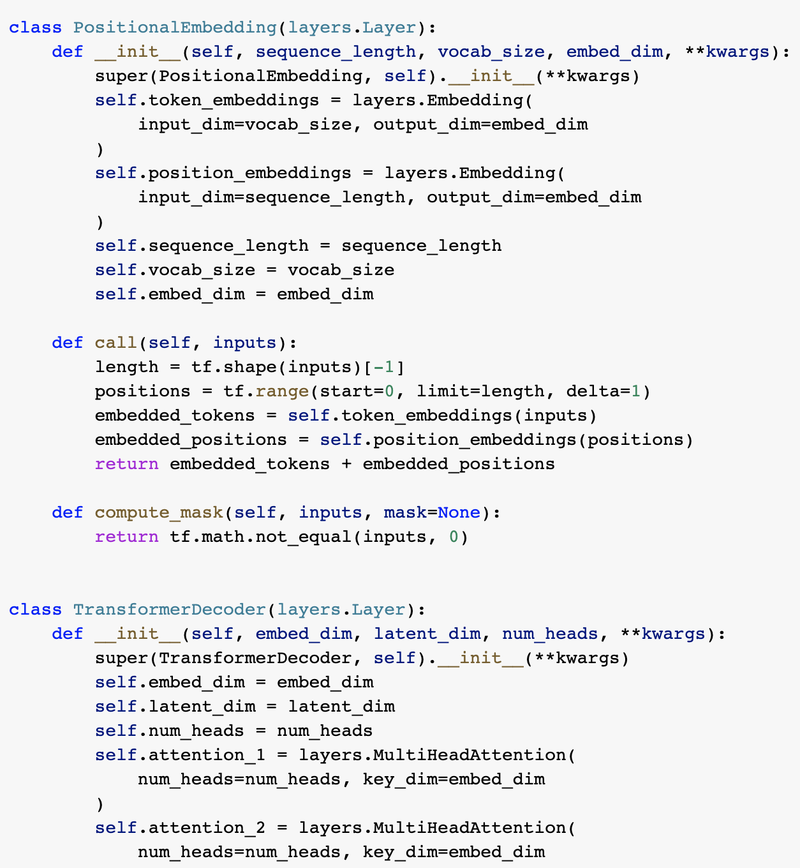
Building the Model
The english is passed to the transformer encoder
A new representation is created and passed to the decoder with the hebrew sentence (target words 0 to N)
Casual masking used so that the transformer decoder sees the entire sequence and that it only uses information from target tokens (0 to N)

Slide 10
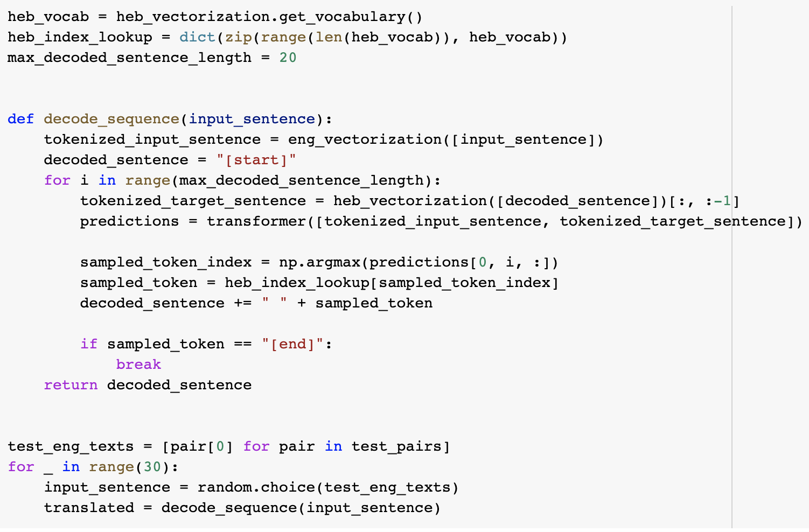
Decoding Test Sentences
The model is fed the vectorized english sentence and target token
Then the next token is fed until the {“END”} token is hit

Slide 11
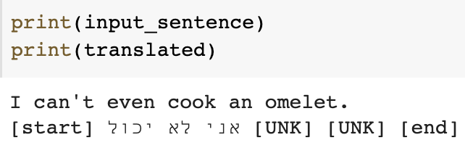
Results
It was found that using the original data source (with no deleted duplicates) and a batch size of 128, 20 character sequence length, and 20 epochs, the accuracy was 69.97%
The second best model had an accuracy of 64.22% and had a batch size of 128, 15 character sequence length, and 20 epochs
Notes:
State which epoch had the best accuracy

Slide 12
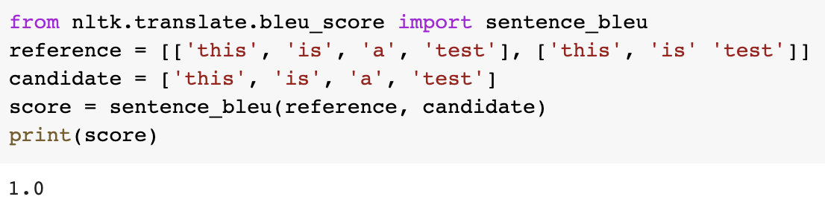
Using BLEU for Accuracy
BLEU is short for bilingual evaluation understudy and is a metric for evaluating machine translated text
BLEU score is a number between 0 and 1
1 represents a perfectly translated sentence
Corpus_bleu() function allows you to calculate the BLEU score for multiple sentences

Slide 13
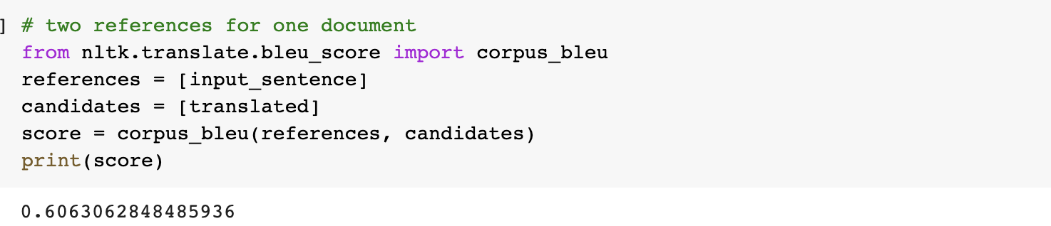
BLEU Score of Translated output
When using the original input sentence “I can’t even cook an omelet” compared to the models translated output the BLEU score calculated was 60.6%

Slide 14
Conclusions & Recommendations
When dealing with a NLP Sequence-to-Sequence transformer, using a larger batch size will increase accuracy
Dataset used must have thousands of pairs and a large training set
Decreasing sequence length decreases the accuracy

